Slide 1
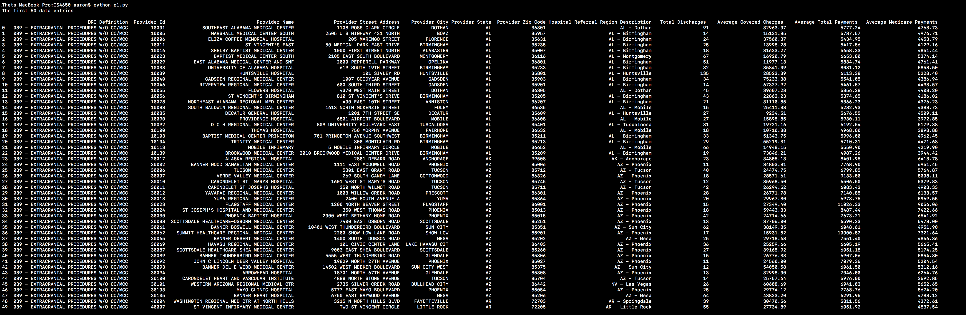
First 50 data entries
print(df.head(50))

Slide 2
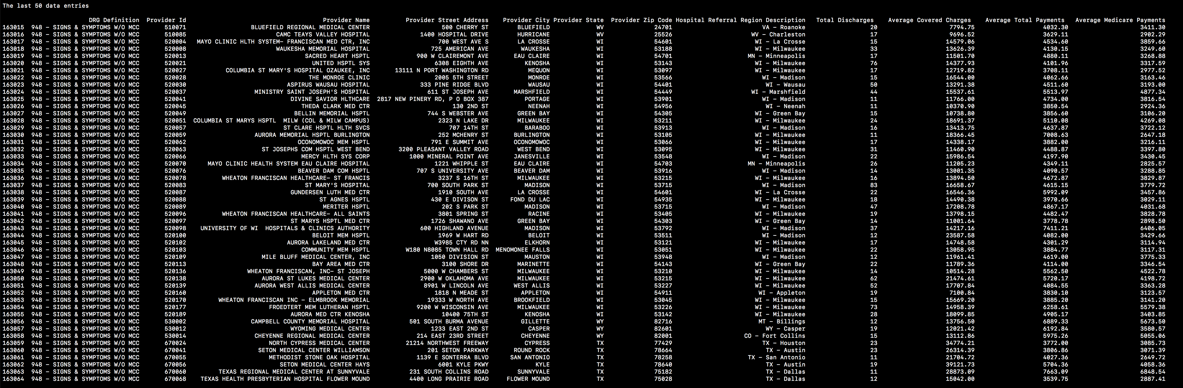
Last 50 data entries
print(df.tail(50))

Slide 3
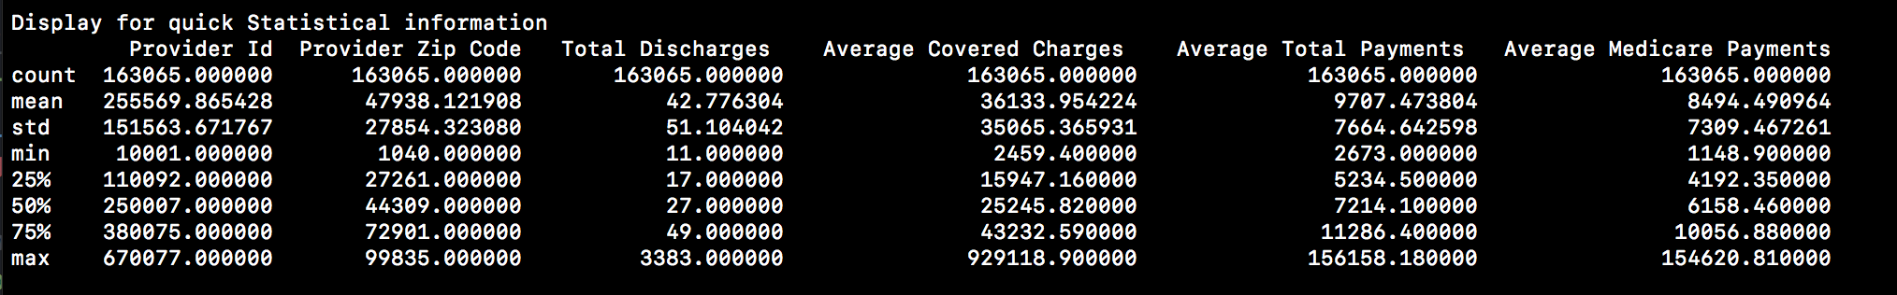
Display for quick Statistical information
print (df.describe())

Slide 4
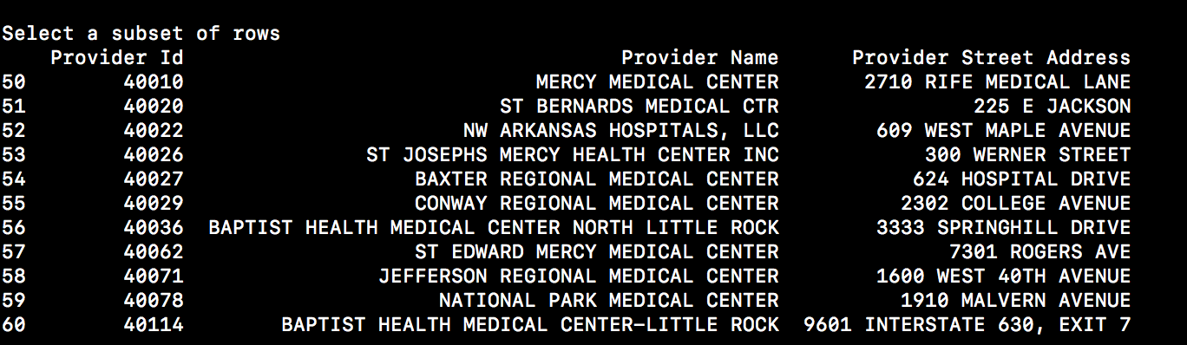
Select a subset of rows
print(df.loc[50 : 60, ['Provider Id', 'Provider Name', 'Provider Street Address']])

Slide 5
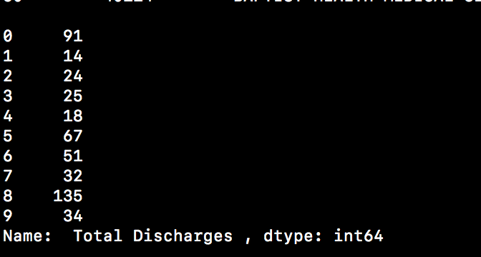
Select a subset of columns
print(df_subcolumn.head(10))

Slide 6
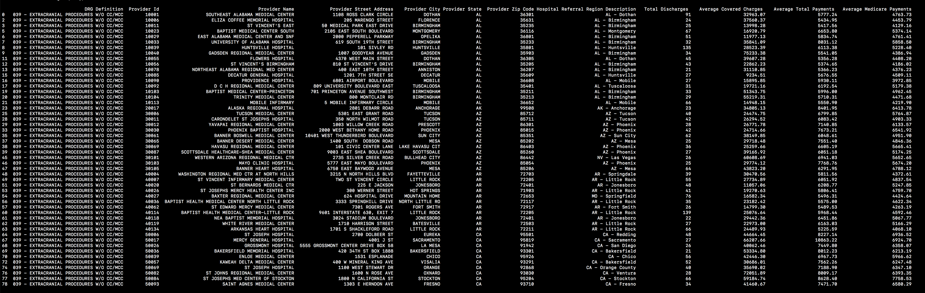
From original data, filter out some data
df_subrow = df[ df[" Total Discharges "] > 20]

Slide 7
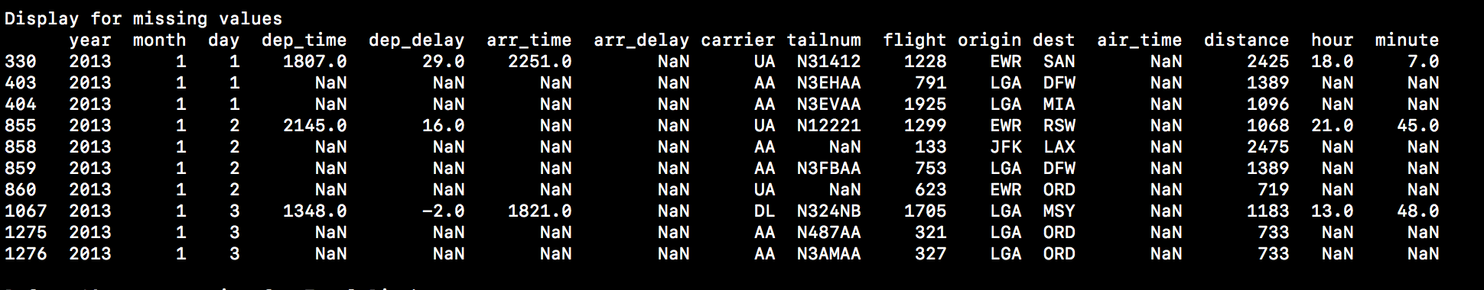
From original data, find out all entries with missing values.
My data set doesn’t have missing values, so I use flight.csv for example
print(flights[flights.isnull().any(axis=1)].head(10))

Slide 8
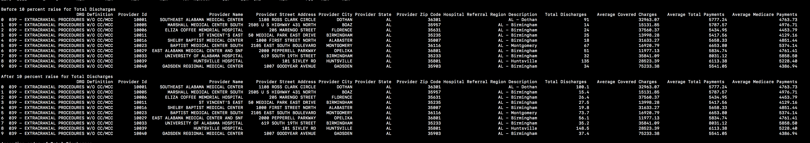
Manipulate the original data by changing numerical values of specific column(s)
ar = (df.head(10)[' Total Discharges '] * 0.1) + df.head(10)[' Total Discharges ']
df[" Total Discharges "] = var

Slide 9

Ascending order
df_sorted = df.sort_values( by = [' Total Discharges '] , ascending = [True])
print(df_sorted.head(10))

Slide 10
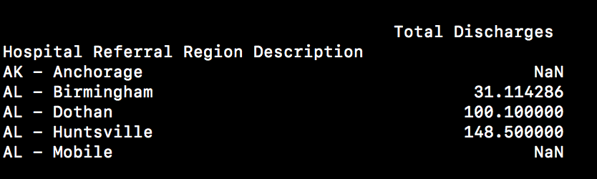
Group the data set
df_region = df_sorted.groupby('Hospital Referral Region Description') [[' Total Discharges ']].mean()

Slide 11
3 plot
﻿￼
￼
￼
df_sorted = pd.read_csv('Inpatient_Prospective_Payment_System__IPPS__Provider_Summary_for_the_Top_100_Diagnosis-Related_Groups__DRG__-_FY2011.csv', index_col = 8)
df_sorted.head(10).boxplot()
df_sorted.head(10).plot(kind= 'bar', stacked = True)
ax = df_sorted.head(10).plot(xticks = range(4), legend=False, style=['r+-','gx-','b*-'], title='My Chart')
ax.set_xlabel('Index')
ax.set_ylabel('Columns')

